Slide 1
Swagger Integration with Flask
API Documentation with Flask-RESTx and Swagger UI
Ahmed Shamir Shazid
Software Engineer Intern
W3 Engineers Ltd.

Slide 2
Project Description
Objective:
Integrate Swagger documentation into an existing Flask application
Benefits:
Standardize API documentation
Easy visualization of endpoints for developers and users
Key Tools:
Flask
Flask_restX
Swagger UI

Slide 3
Project Features
Endpoints:
/users:
GET: List all users
POST: Create a new user
/users/<id>:
GET” Retrieve a user by ID
PUT: Update a user’s details
DELETE: Remove a user by ID
API Documentation:
Auto-generated Swagger UI
Interactive testing interface

Slide 4
Tools and Technologies
Flask:
A lightweight Python web framework
Flask-RESTx:
Extension for building REST APIs with Swagger integration
Swagger UI:
Interactive documentation for APIs
Python Libraries:
flask
Flask-restx
datetime

Slide 5
Installation Process
1. Clone the Repository:
git clone https://github.com/Shazid18/Swagger_Documentation.git
cd Swagger_Documentation
2. Create a Virtual Environment:
python3 -m venv venv
3. Activate virtual Environment:
source venv/bin/activate

Slide 6
Installation Process
4. Install Dependencies:
pip install -r requirements.txt
5. Run The Service:
cd service
python app.py
6. Access Swagger UI:
Open your browser and navigate to: http://127.0.0.1:5000/swagger

Slide 7
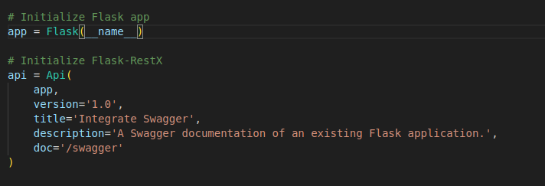
Code Overview
API Initialization:

Slide 8

Code Overview
Namespace Creation:
Endpoint Implementation:
@ns.route(): Defines routes.
@ns.doc(): Adds endpoint-specific details
@ns.marshal_with(): Specific response format

Slide 9
Swagger UI Overview
Interactive Documentation:
Lists all API endpoints
Allows real-time testing of endpoints with proper documentations

Slide 10
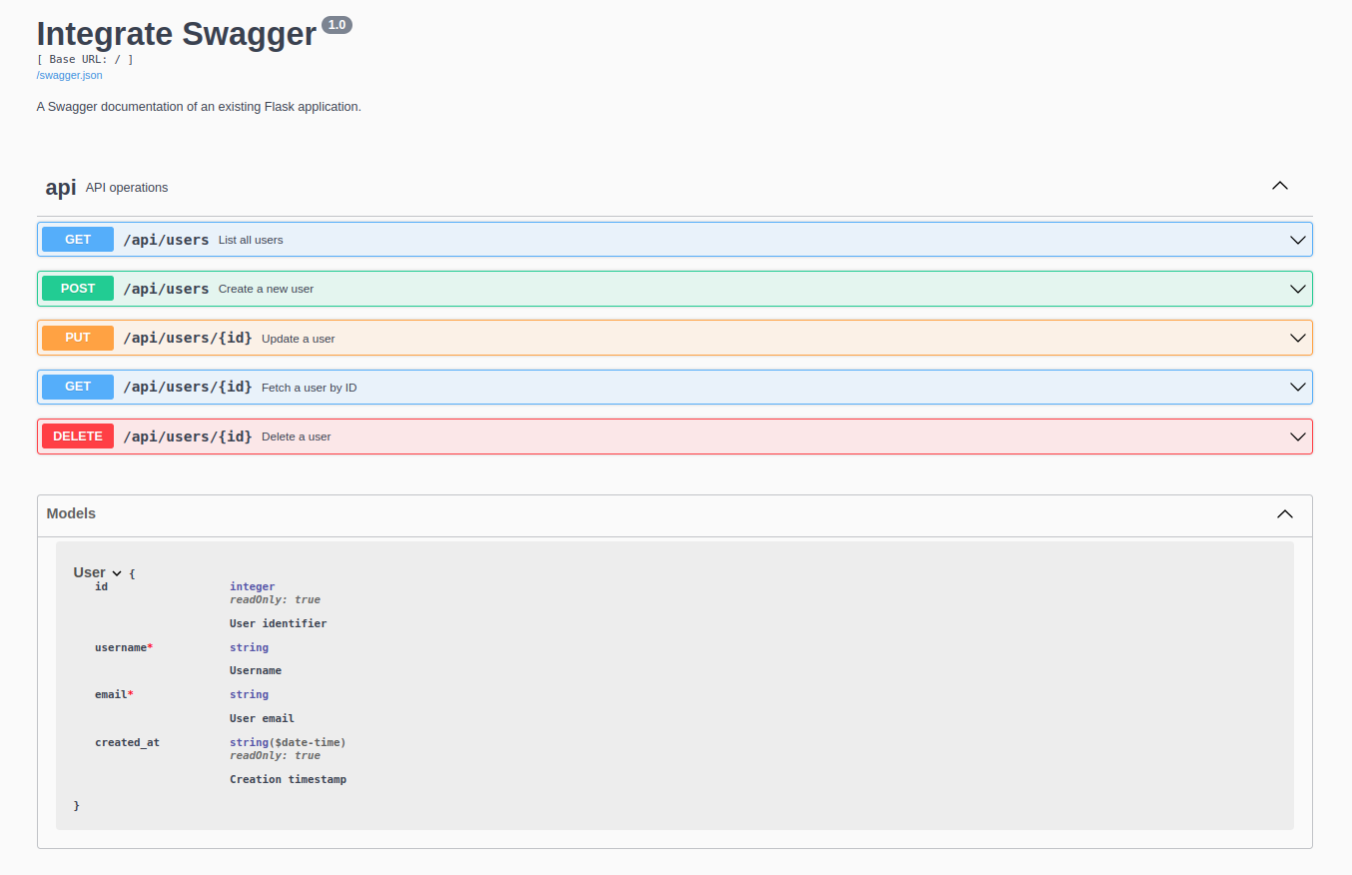
Swagger UI Overview

Slide 11
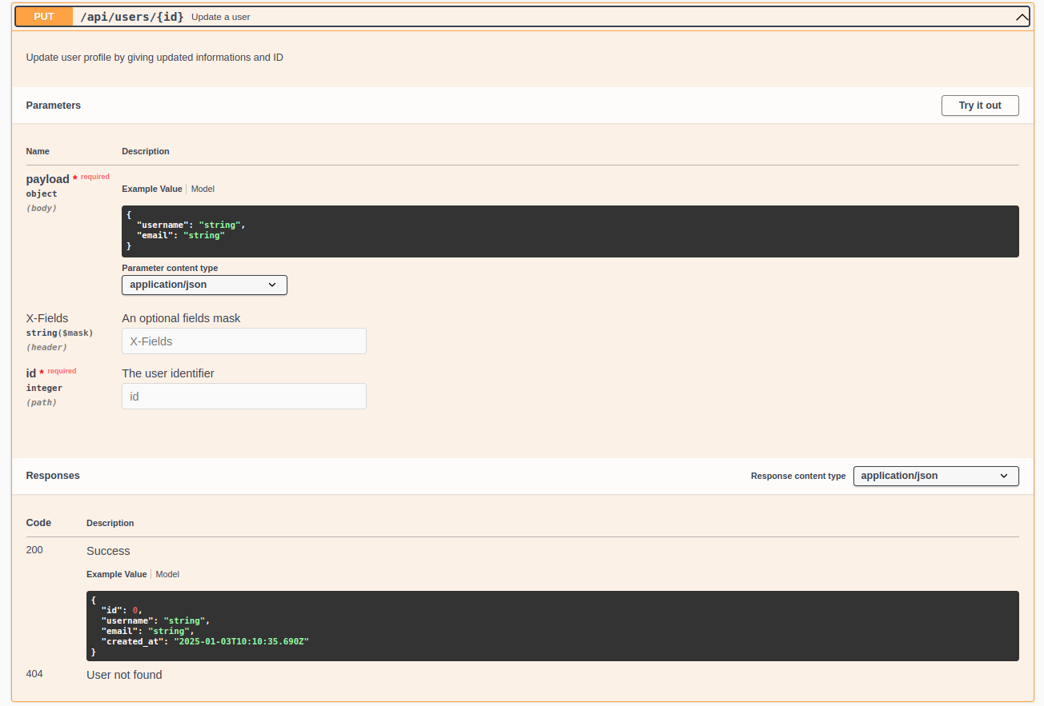
Swagger UI Overview

Slide 12
Thank You

